Slide 1

DEMAND FORECASTING ON E-COMMERCE
LINGANABOINA PRANAY
19-JULY-2024

Slide 2
CONTENTS
Problem Statement
Dataset Overview
Exploratory Data Analysis
Feature Engineering
Visualisation
Time Series Analysis
Demand Forecasting Models
Comparison Of All Forecasting Models
Conclusion

Slide 3
1. Problem statement
This project aims to develop a sophisticated model using historical sales data and Google Analytics KPIs, like Google clicks and Facebook impressions.
To predict future product demand and understand customer behavior.
OUTCOMES
Develop Demand Forecasting Model
Identify Trends and Seasonal Patterns
Build Predictive Models

Slide 4
2. Dataset overview
ProductA.csv:
Contains data related to product demand, including day index and quantity sold.
Used for analyzing trends and forecasting demand.
ProductA_google_clicks.csv:
Includes daily data on Google clicks.
Helps in understanding the correlation between Online advertising and product demand.
ProductA_fb_impressions.csv:
Captures daily Facebook impressions.
Useful for examining the impact of social media advertising on product demand.

Slide 5
3. Exploratory Data Analysis
Merging the data :
Initially the data contains , Product A : (212, 4) Product A Google Clicks : (212, 4) Product A Facebook Impressions : (212, 4)
Merged the three datasets with Day Index column . Merged data : (212, 4)
Here for no data loss , we used left join.

Slide 6
Missing values imputation : There are no missing values.
Outlier detection and replacement : Identify Outliers:
Calculate Q1 (25th percentile) and Q3 (75th percentile)
Compute IQR (Interquartile Range):
IQR=Q3−Q1
Define bounds: Lower=Q1−1.5×IQR, Upper=Q3+1.5×IQR
Quantity column contains outliers.
Replaced the outliers with median value of the Quantity column.

Slide 7
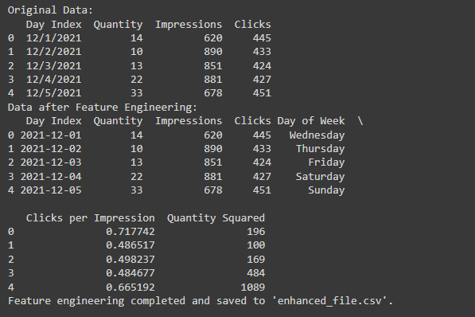
4. Feature Engineering
Date-related Features
Month-specific Features
Day-specific Features
Quantity,Impressions,clicks
Clicks per impressions
Quantity squared

Slide 8
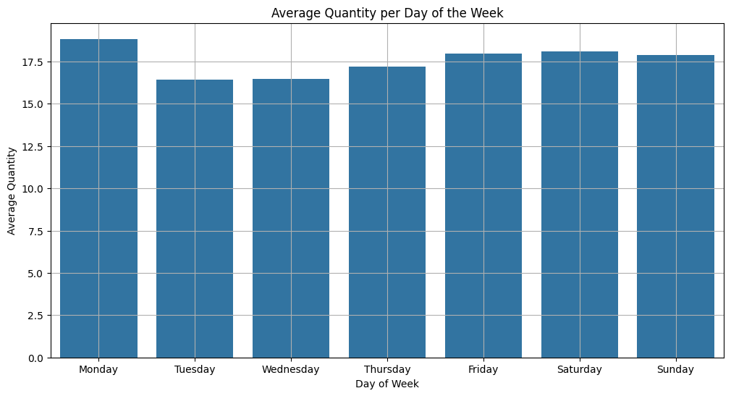
5. Visualisation
We can observe that Monday has highest quantity and Tuesday has lowest quantity.

Slide 9
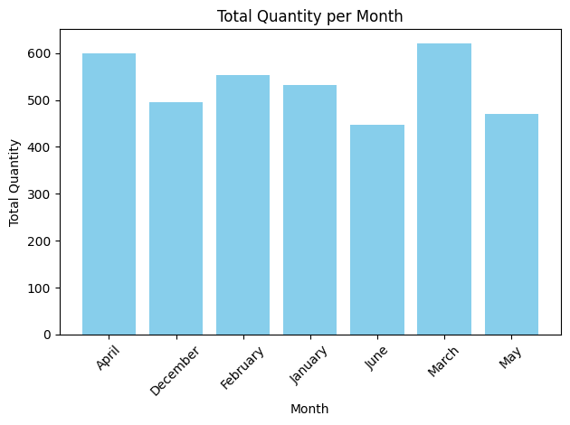
From the graph we can say that March has the highest quantity and June has lowest quantity.

Slide 10
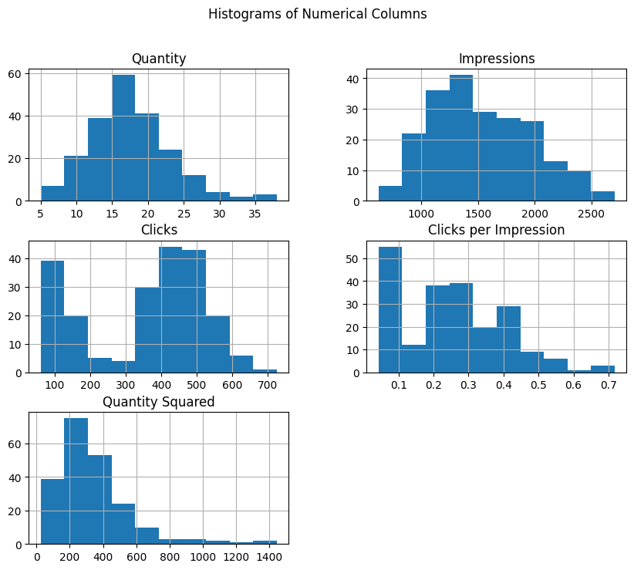
Quantity: There are a few values above 30, which appear to be outliers compared to the bulk of the data centered around 10-20.
Impressions: There are a few data points above 2500, indicating possible outliers.
Clicks: Values above 600 appear as outliers, as most of the data is centered around 200-500.
Quantity Squared: Values above 1200 seem to be outliers, with the majority of the data clustering below this range.
Clicks per Impression: Values above 0.6 could be considered outliers since the majority of data points are below this value

Slide 11
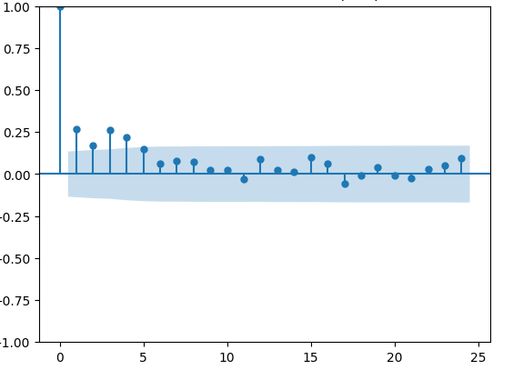
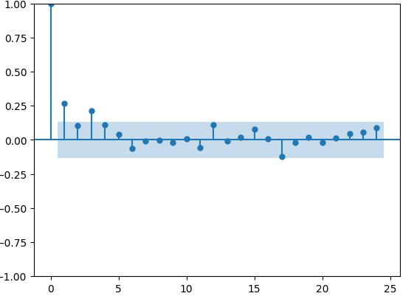
6. Time Series Analysis
Autocorrelation Function
Partial Autocorrelation Function
In the given ACF plot, significant spikes are observed at 1,2 and 3
Followed by a rapid decline . This suggests a q value around 1 or 2.
In the given PACF plot, significant spikes are observed at 1,2 and 3
Followed by a rapid decline . This suggests a q value around 1 or 2.

Slide 12
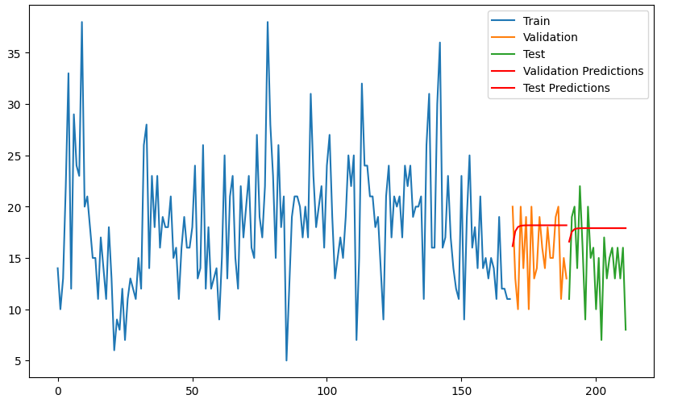
7. Demand forecasting models
AR Model
Validation Metrics:
RMSE : 4.21
MAPE : 0.27
R² : -0.61
Adjusted R²: -0.79
Test Metrics:
RMSE : 4.99
MAPE : 0.37
R² : -0.69
Adjusted R²: -0.87

Slide 13
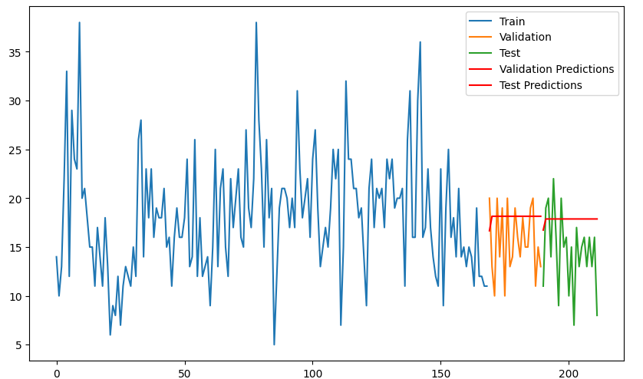
MA Model
Validation Metrics:
RMSE : 4.21
MAPE : 0.27
R² : -0.61
Adjusted R²: -0.90
Test Metrics:
RMSE : 4.98
MAPE : 0.37
R² : -0.687
Adjusted R²: -0.97

Slide 14
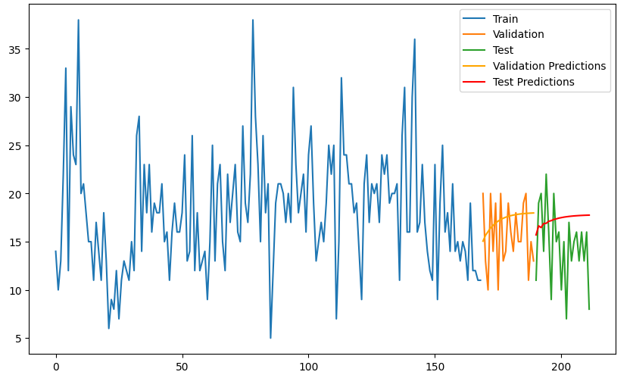
ARIMA Model
Validation Metrics:
RMSE : 3.81
MAPE : 0.24
R² : -0.32
Adjusted R²: -0.88
Test Metrics:
RMSE : 4.81
MAPE : 0.35
R² : -0.57
Adjusted R²: -1.20

Slide 15
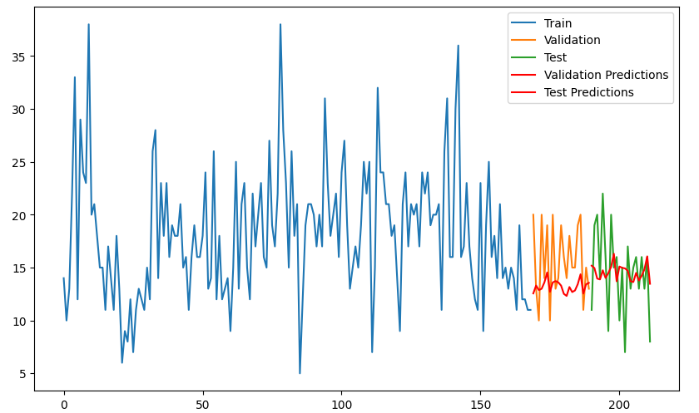
SARIMA Model
Validation Metrics:
RMSE : 3.96
MAPE : 0.19
R² : -0.43
Adjusted R²: -1.20
Test Metrics:
RMSE : 3.83
MAPE : 0.24
R² : -0.001
Adjusted R²: -0.31

Slide 16
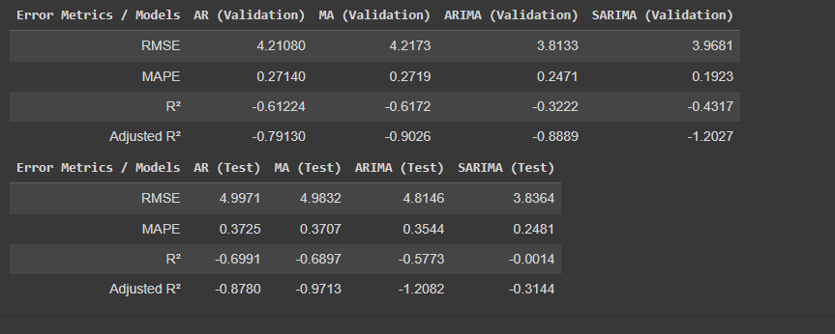
8. Comparison Of All Forecasting Models
For Validation Dataset and test dataset:
ARIMA model shows the best performance on the validation data,with the lowest RMSE

